Slide 1
Spring MVC
Part 2
Session Tracking

Slide 2
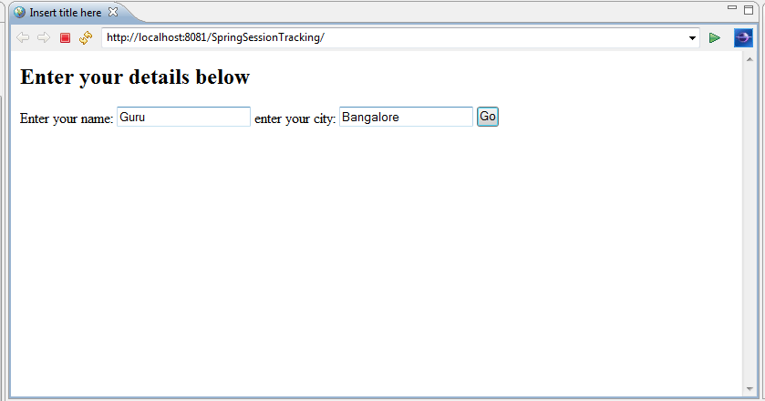
Sample Application Screen 1

Slide 3
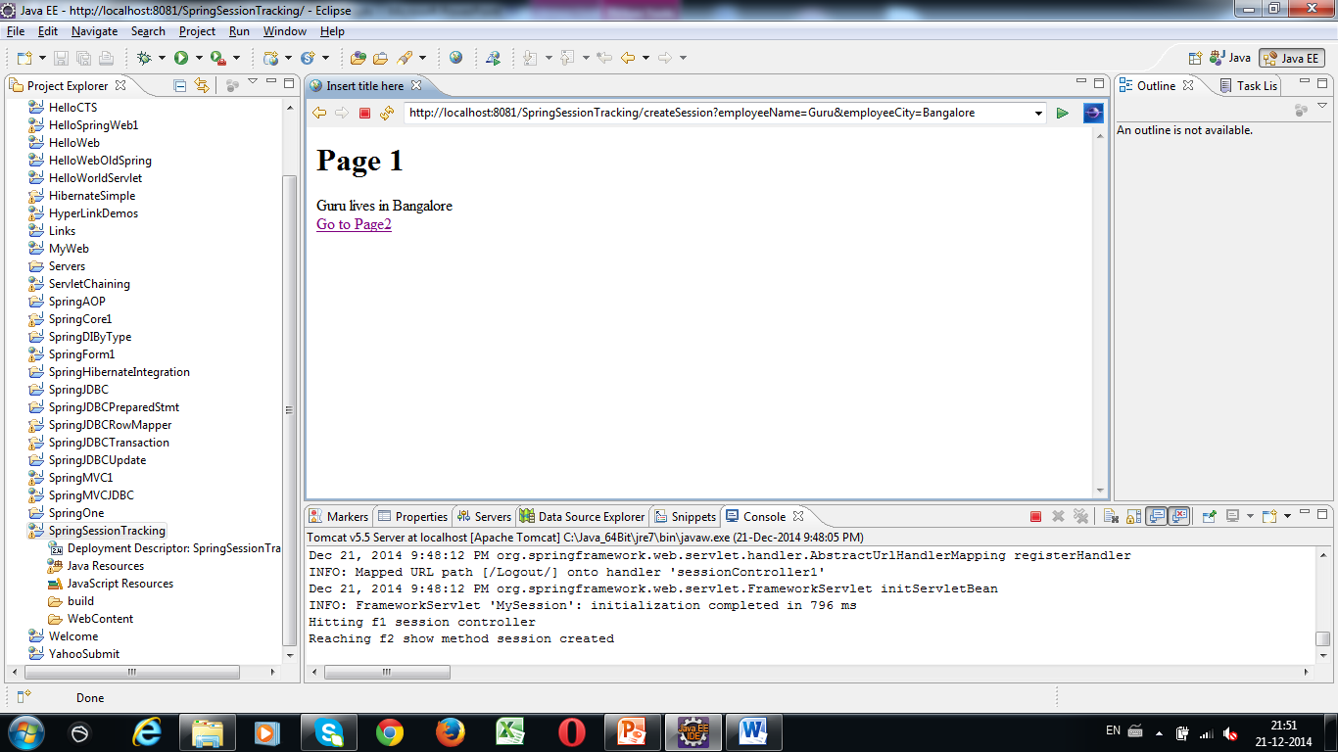
Sample Application Screen 2

Slide 4
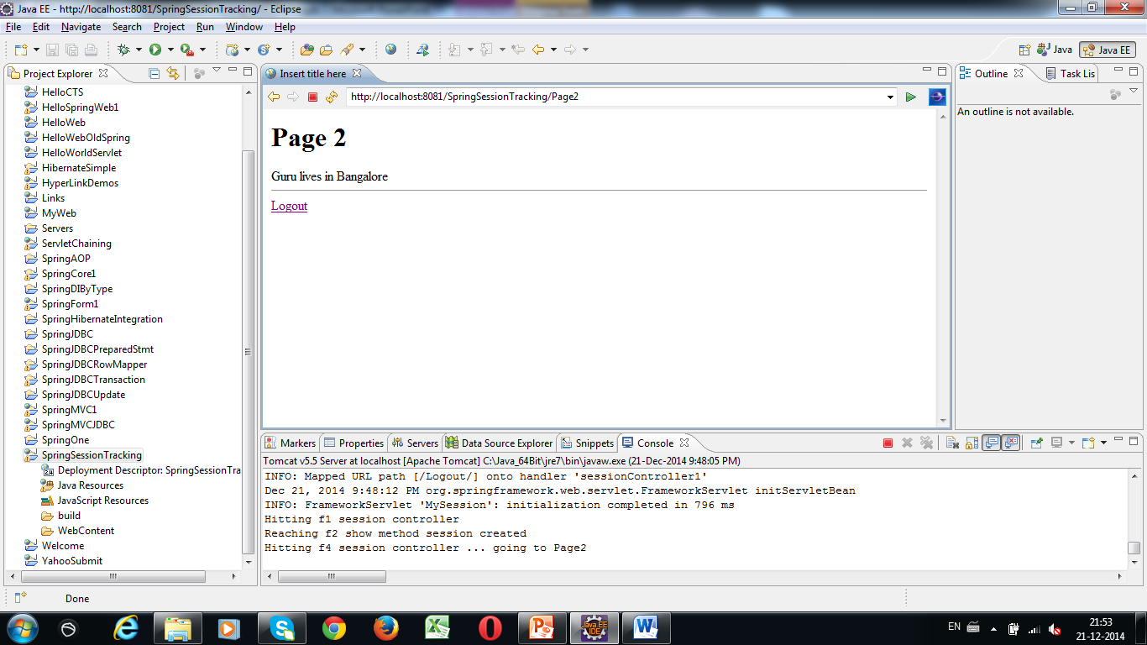
Sample Application Screen 3

Slide 5
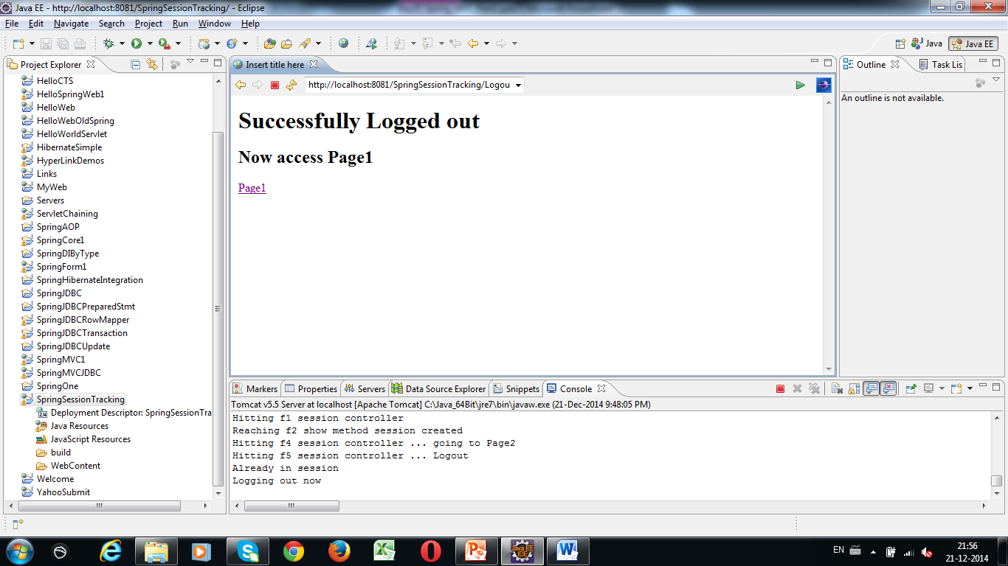
Sample Application Screen 4

Slide 6
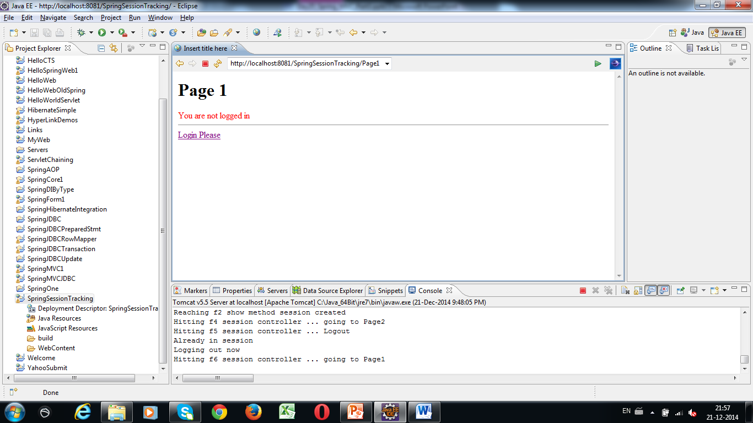
Sample Application Screen 5

Slide 7
Developing Session Tracking Step 1
Create Dynamic Web Project
With the name SpringSessionTracking
Add required libraries

Slide 8
Developing Session Tracking Step 2
Create web.xml
Give the name “MySession” to your DispatcherServlet

Slide 9
Developing Session Tracking Step 3
Create MySession-servlet.xml under WEB-INF
Enter the tag <context:component-scan…>
Define the bean for InternalResourceViewResolver class
Define prefix and suffix properties

Slide 10
Developing Session Tracking Step 4
Create the following jsp files under WEB-INF/myjsp folder
Form.jsp (for data input)
Page1.jsp (for showing data)
Page2.jsp (for showing data and Logout link)
Logout.jsp (for showing logout msg)

Slide 11
Developing Session Tracking Step 5
Create the POJO class with the name Employee
Define the properties: employeeName and employeeCity
Generate setters and getters

Slide 12
Developing Session Tracking Step 6
Create Controller class with the name “SessionController”
Add the @Controller annotation before the class name

Slide 13
Developing Session Tracking Step 7
Let’s add 5 methods in this controller class
public ModelAndView f1()
public String f2(@ModelAttribute Employee emp, HttpServletRequest request)
public String f3()
public String f4()
public String f5(HttpServletRequest request)

Slide 14
Developing Session Tracking Step 8 Controller - First method
@RequestMapping(value="/", method=RequestMethod.GET)
public ModelAndView f1()
{
Employee e=new Employee();
ModelAndView mav=new ModelAndView("Form","",e);
return mav;
}

Slide 15
Developing Session Tracking Step 8 Controller - Second method
@RequestMapping(value="createSession", method=RequestMethod.GET)
public String f2(@ModelAttribute Employee emp, HttpServletRequest request)
{
HttpSession session=request.getSession(true);
session.setAttribute("employeeObj",emp);
return "Page1";
}

Slide 16
Developing Session Tracking Step 8 Controller - Third method
@RequestMapping(value="Page2", method=RequestMethod.GET)
public String f3()
{
return "Page2";
}

Slide 17
Developing Session Tracking Step 8 Controller - Fourth method
@RequestMapping(value="Page1", method=RequestMethod.GET)
public String f4()
{
return "Page1";
}

Slide 18
Developing Session Tracking Step 8 Controller – Fifth method
@RequestMapping(value="Logout", method=RequestMethod.GET)
public String f5(HttpServletRequest request)
{
HttpSession session=request.getSession(false);
String str=“”;
if (!session.isNew()) {
session.invalidate();
str=“Logout”;
}
return str;
}

Slide 19
Developing Session Tracking Step 9 Create JSP Pages
Create Form.jsp with two text fields with the following name:
employeeName
employeeCity
<form action=“createSession”>

Slide 20
Developing Session Tracking Step 9 Create JSP Pages
Create Page1.jsp:
<%
session=request.getSession();
Object o=session.getAttribute("employeeObj");
if (o!=null)
{
Employee ee=(Employee)o;
out.println(ee.getEmployeeName()+" lives in "+ee.getEmployeeCity()+"<br>");
out.println("<a href=\"Page2\"> Go to Page2</a>");
}
else
{
out.println("<font color=red>You are not logged in<hr></font>");
%>
<a href="http://localhost:8081/SpringSessionTracking">Login Please</a> <% } %>

Slide 21
Developing Session Tracking Step 9 Create JSP Pages
Create Page2.jsp:
<%
session=request.getSession();
Object o=session.getAttribute("employeeObj");
if (o!=null)
{
Employee ee=(Employee)o;
out.println(ee.getEmployeeName()+" lives in "+ee.getEmployeeCity());
}%>
<hr>
<a href="Logout">Logout</a>

Slide 22
Developing Session Tracking Step 9 Create JSP Pages
Create Logout.jsp:
<h1> Successfully Logged out</h1>
<h2> Now access Page1</h2>
<a href="Page1"> Page1</a>

Slide 23
Developing Session Tracking Step 10 Testing
Unit test the servlet MyServlet
Refresh the project
Right click project…Run as…Run on server

Slide 24
T
H
A
N
K
Y
O
U

